Slide 1

AURUM: A DATA DISCOVERY SYSTEM
GROUP - 7
Susmitha Marripalapu (A20489531)
Pranava Brunda Manuguri (A20472679)
Yogith Reddy Venkanagari (A20493317)

Slide 2

OVERVIEW
Modern organizations face a data discovery problem.
Find data sources containing needed information among the many thousands of tables in RDBMS, data lakes and warehouses in the organization.
Large drug company
Company’s stock variation in recent elections.
No.of drugs about to be approved by FDA
Predict stock price of a company after presidential elections
Mentions of company in social media handles
Current productivity of research and development.

Slide 3

WHY DATA DISCOVERY SYSTEM ???
PROBLEM Organizations face a data discovery problem when their analysts spend more time looking for relevant data than analyzing it.
WHY IS IT ESSENTIAL?
Addition of new data and the scale of data generation process.
To be able to work with structured or unstructured data.
Ability to provide querying flexibility to support any type of data needs.

Slide 4

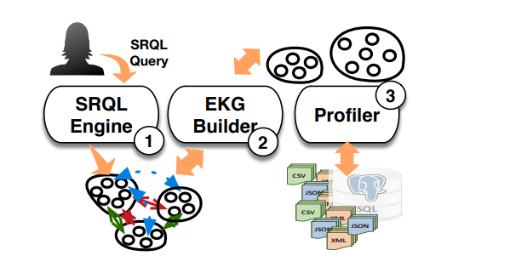
AURUM ARCHITECTURE
MAJOR COMPONENTS
1. SRQL Engine
2. EKJ Builder
3. Profiler

Slide 5
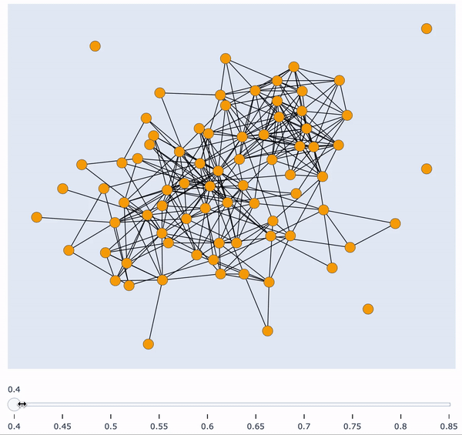
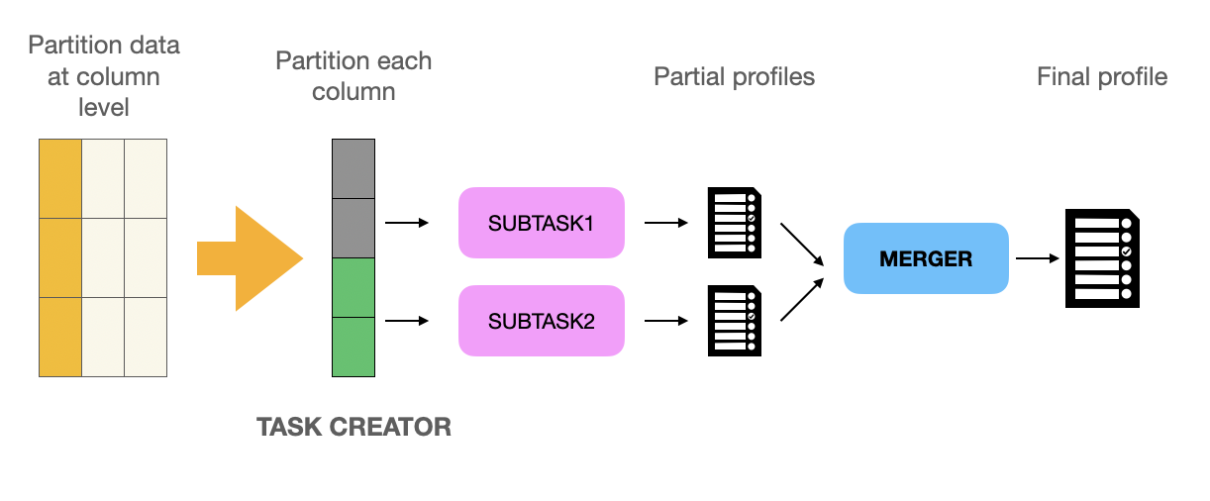
ENTERPRISE KNOWLEDGE GRAPH (EKG)
CHALLENGES
Using naive method, takes multiple access rounds to data and is heavy CPU.
BUILDING EKG
PROFILER : Reads data in one pass.
Signature building Content sketches, Cardinality,data distributions, types etc
SOURCE and SINK

Slide 6
GRAPH BUILDER
RELATIONSHIP BUILDER
Computes the syntactic relationships between the columns in the database using the profiles.
Create relationship if signatures are similar, hashed using LOCAL SENSITIVE HASHING.
Relationship strength:
Jaccard similarity
Cosine similarity
Primary key : Content similarity, Uniqueness_ratio
Foreign key : Attribute similarity

Slide 7

MAINTAINING - EKG
Keep the EKG up to date without having to recompute everything from scratch.
Keep access to the underlying data sources to a minimum
RESS Algorithm (Resource-Efficient Signature Sampling)
C, Collection of columns from all databases
S = random(c)
X = store[c].no.unique_val
JSmax = s/x
M, where M ∈ C is the set of columns that need a new
profile
Store to retrieve profiles
for c ∈ C
δ = 1 − JS0/JSmax
if δ > γ
γ , maximum magnitude of change
smh = minhash(S)
xmh = store[c].contentsSignature
JS0 = jaccard(smh,xmh)
recompute(M, c);

Slide 8

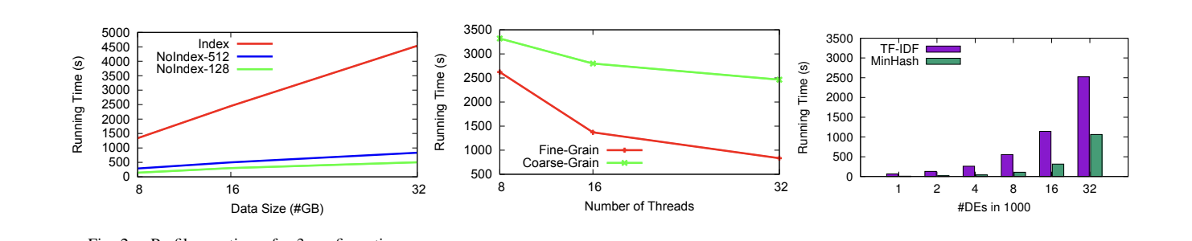
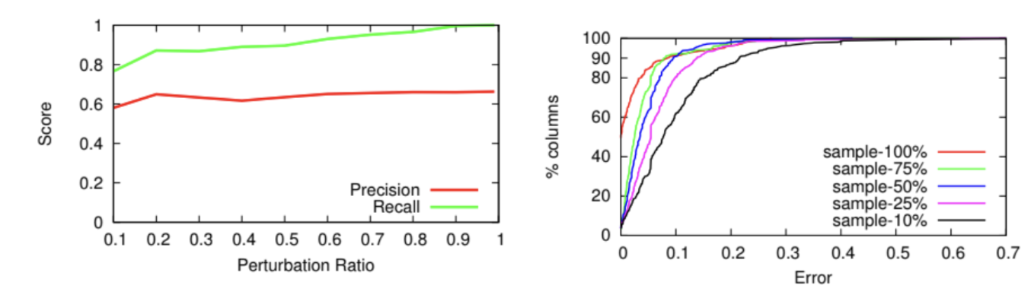
EVALUATING PERFORMANCE
BUILDING EKG
MAINTAINING EKG
Profiler runtimes
Precision and Recall as a function of change
with 10% sample
Absolute error for different sample sizes.
Graph builder runtimes with increase DEs

Slide 9

QUERYING EKG
Querying using SRQL (Source Retrieval Query Language)
Mainly focus on two concepts:
1. Discoverable Elements(DE’s)
2. Discovery Primitives(DP’s)
The Discovery primitives divided into two groups.
1. Pure
2. Lookup
SRQL language uses Discovery Result Set (DRS) to support metadata functionality.

Slide 10

QUERYING EKG
Find similar content across all databases
Broad Search of Related Source:
Schema Search is used to find all the columns across all databases by using keywords.
For example: keywords such as “Sales”, “profits”.
Query: results=SchemaSearch(“sales”,”profits”)
Searching For Similar Content:
ContentSim is the command that used to search the similar range of content and their syntactic relationships.
Apply columns to input tables
Apply primitive logic to each input individually
Combine results per column using OR primitive

Slide 11
SRQL EXECUTION ENGINE
G-index:
The G-Index is a space-efficient in-memory representation of the EKG and it is constructed incrementally along with the EKG.
G-index serves as a framework to write new strategies if needed and this provenance graph is sufficient to express ranking strategies.
Ranking Strategies:
Certainty ranking- it is a default technique, that uses weights(obtained from the provenance graph) from sinks to sources and combines the weights.
The time we reach junction, it will choose the upstream link with highest weights and continue the path.
Coverage ranking - it is a more advanced ranking approach for SRQL queries that deliver tables as output.where a query's output tables are sorted in relation to the input DEs.

Slide 12

CONCLUSION
Systems orthogonal to the problem AURUM is trying to solve. Don’t permit users to change queries on demand.
WhereWorks by Linkedin
Atlas by Apache foundations
Goods by Google
The experiments so far with AURUM helped to confirm that AURUM is useful for varied discovery needs.
Future Work :
Working with organisations to achieve a deeper integration in their environments, with the hope of discovering more details and related problems.

